Slide 1
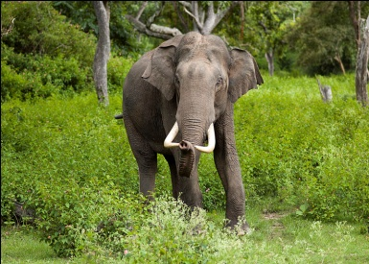
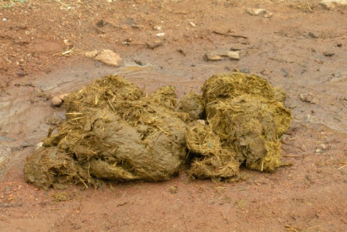
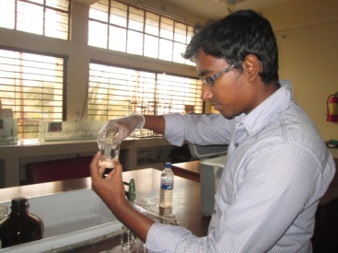
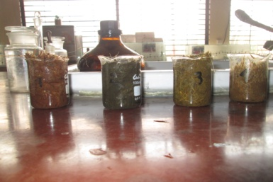
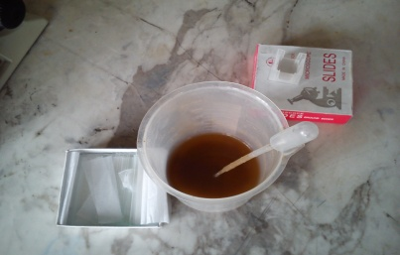
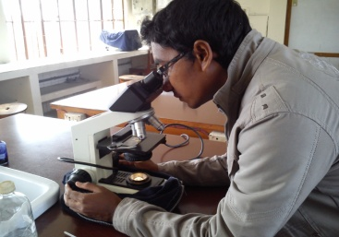
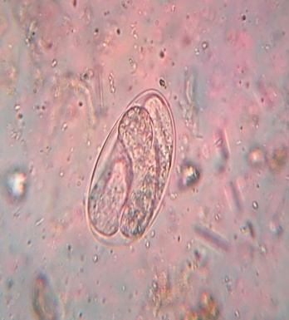
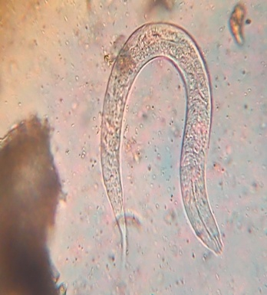
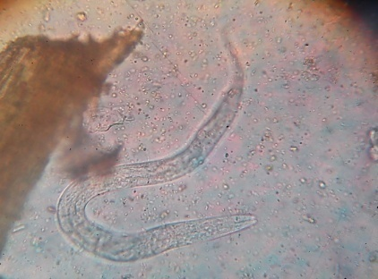
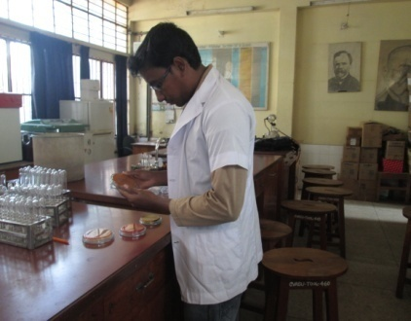
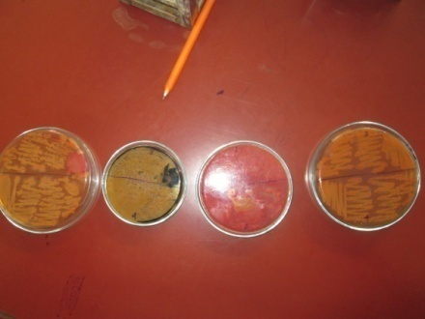
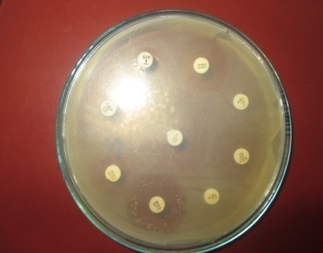
Photo Gallery
Fig-1: Asiatic Elephant of Safari park
Fig-2: Feces of Elephant
Fig-3: 10% formalin was used as preservative
Fig-4: Four fecal samples were preserved with 10% formalin
Fig-5: Sediment of feces
Fig-6: Coproscopy
Fig-7: Egg of Strongyles
Fig-8: Larva of Choniangium sp
Fig-9: Larva of Decrusia sp
Fig-10: Observation of colony formation
Fig-11: Colony formation on every sample
Fig-12: Cultural Sensitivity (CS) test

