Slide 1
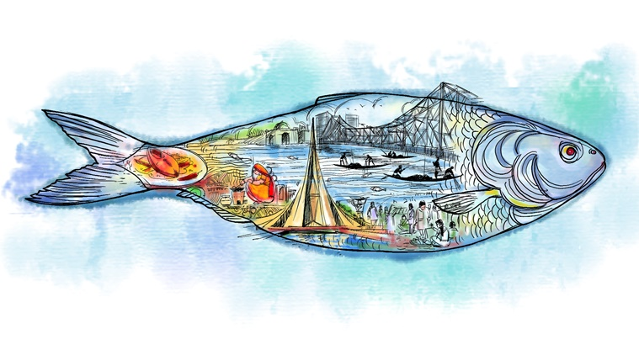
Welcome to my presentation
Mithun Das
MS Fellow
Roll no. 0117/05
Reg. no. 0458
Dept. of Fish Biology and Biotechnology
Faculty of Fisheries, CVASU

Slide 2
Research Title
Landmark-Based Morphometric and Meristic Variations in Two Congeneric Hilsha Fishes (Tenualosa ilisha and Tenualosa toli ) from Bangladeshi Waterbodies

Slide 3
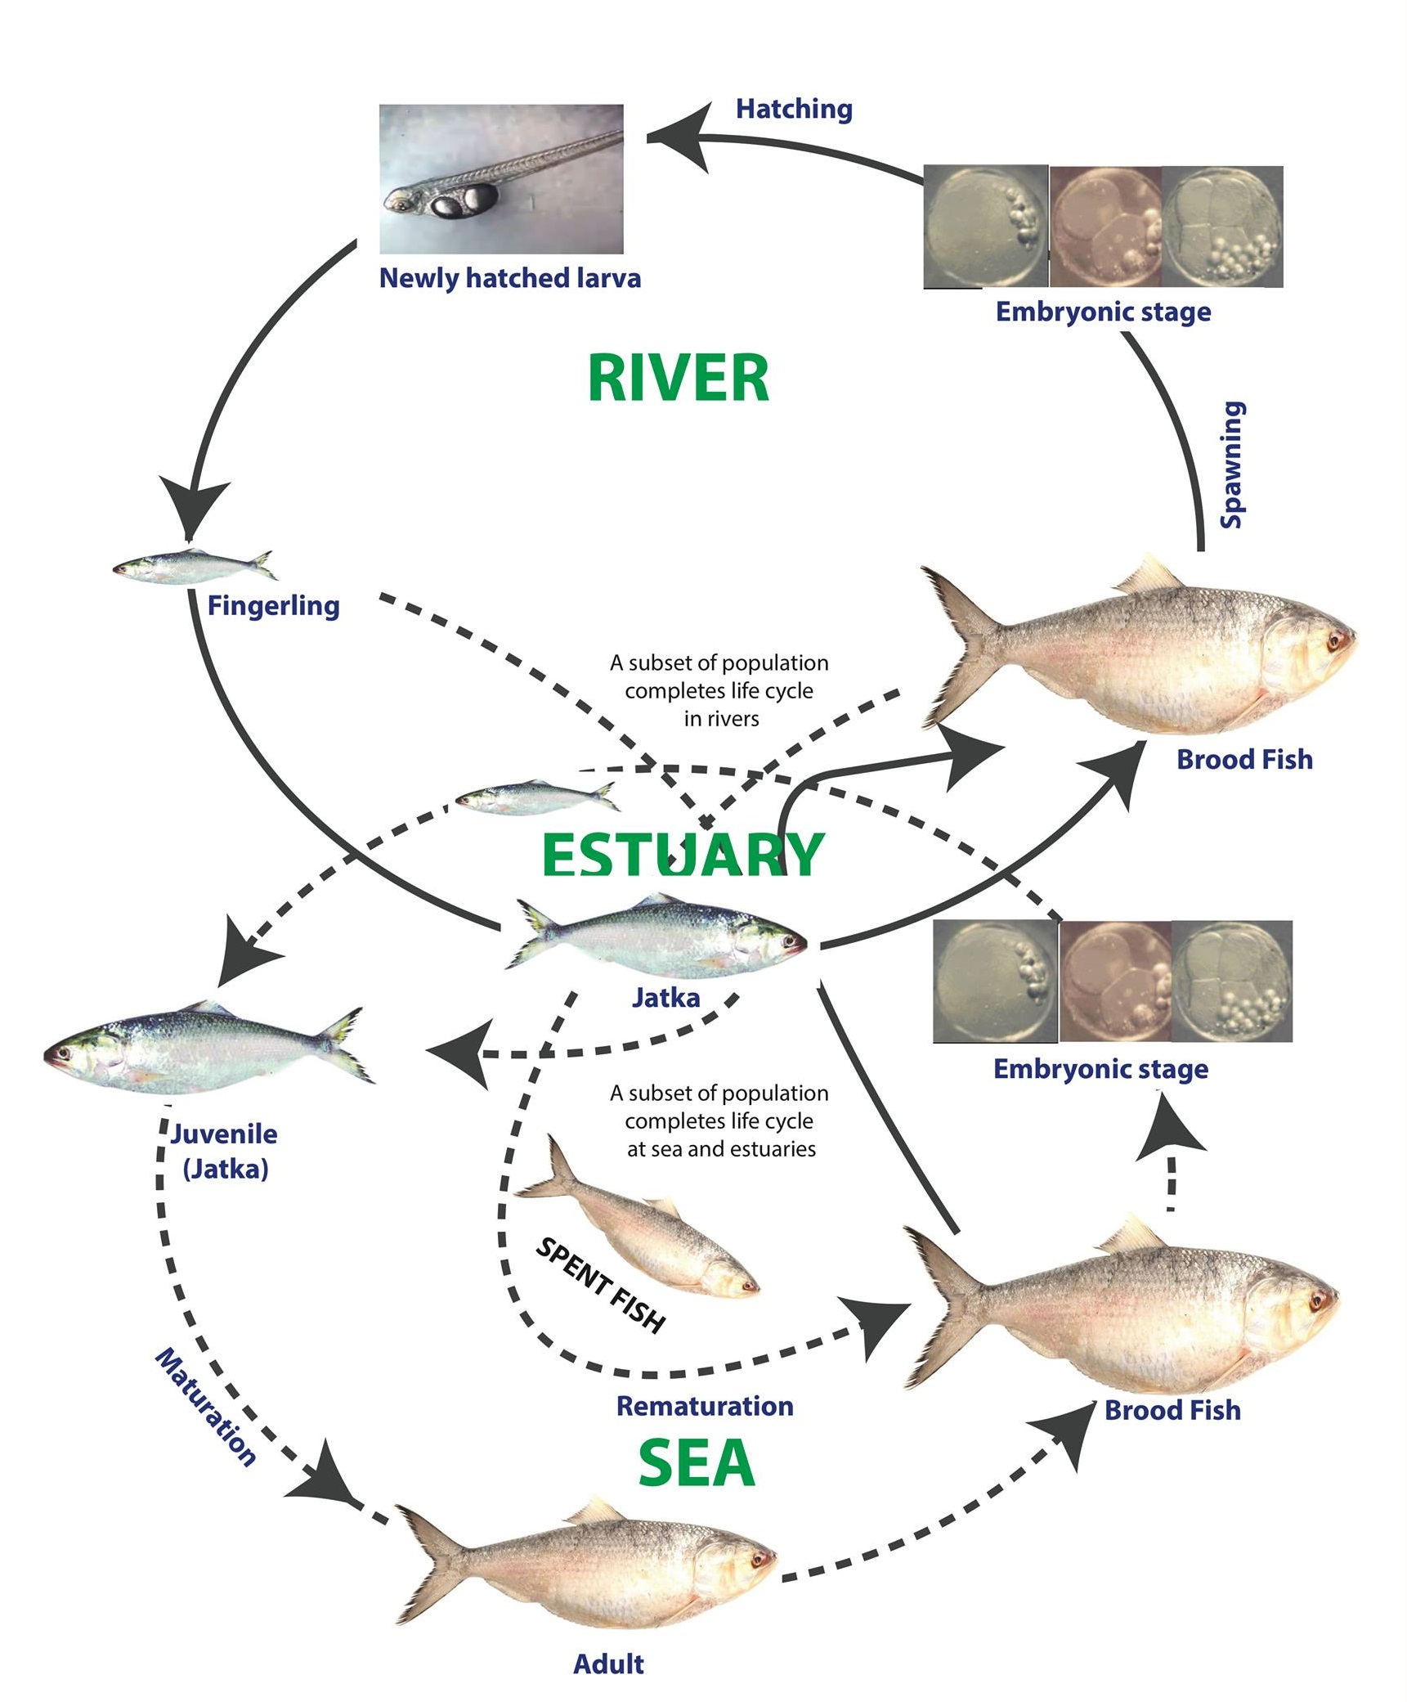
Introduction
Life cycle of hilsha (modified from Hossain et al., 2016)
Hilsha fish, the national fish of Bangladesh
Important tropical fish of genus Tenualosa
Hilsa (Tenualosa ilisha), also the largest single species fishery in Bangladesh
Anadromous (available in the rivers, estuaries and the sea)
Have a wide distribution in the Bay of Bengal and the rivers of Bangladesh

Slide 4
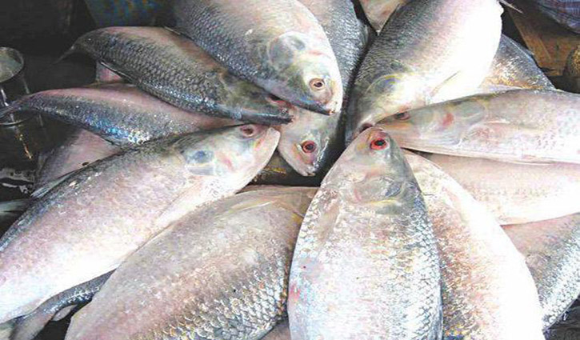
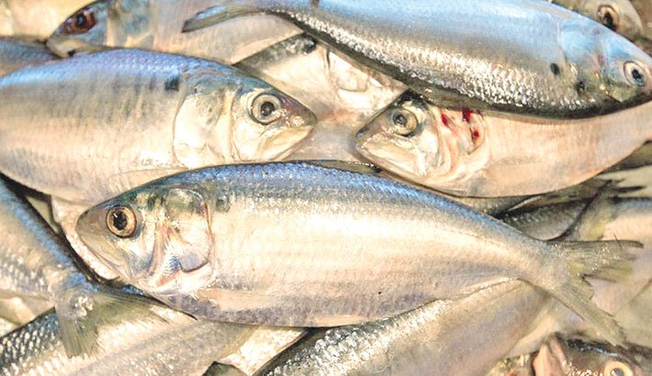
3 species of hilsha fish are available in Bangladesh
The following two species are the most common…
Padma ilish or hilsha shad (T. ilisha) Chandana ilish (T. toli)

Slide 5
Objectives
To evaluate the morphometric and meristic variations between T. ilisha and T. Toli
To determine possible differences between separate unit stocks of the same species (variations among the stocks of T. ilisha)
To differentiate closely related species of Tenualosa more precisely based on their morphology

Slide 6
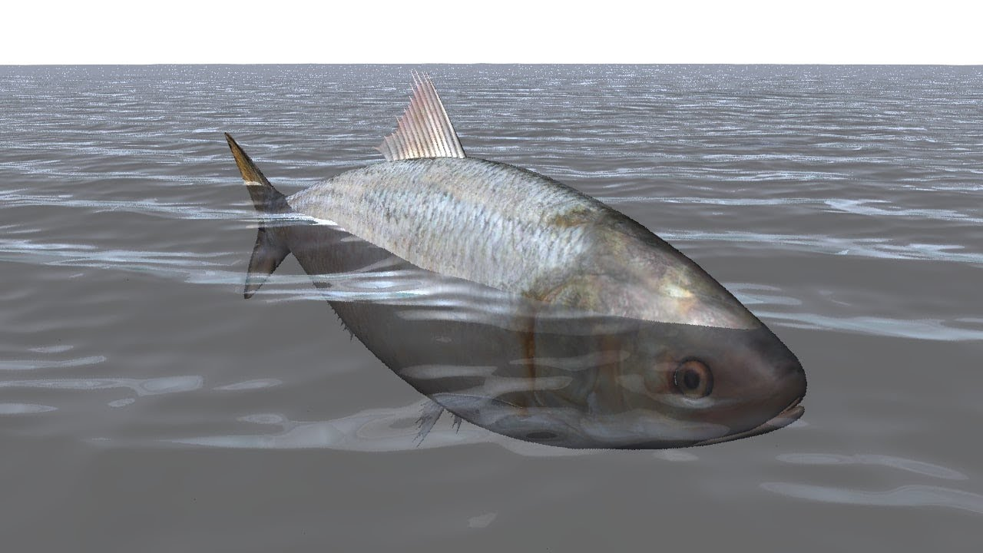
Materials and Methods

Slide 7
1. Collection of samples
Species | Habitats | Source/location | Total length (cm) | Sample size
T. ilisha | Marine | Cox’s Bazar | 25.68 ± 1.17 | 16
T. ilisha | River | Chandpur | 31.65 ± 1.15 | 16
T. ilisha | Coastal | Chittagong | 26.43 ± 0.77 | 16
T. toli | Coastal | Chittagong | 28.57 ± 1.62 | 16
Total 64 samples

Slide 8
Analysis based on…
Morphological characters
Morphometric characters : measurable characters of fish
example. Different length on fish body
Meristic characters : countable characters of fish
example. Number of different fin rays

Slide 9
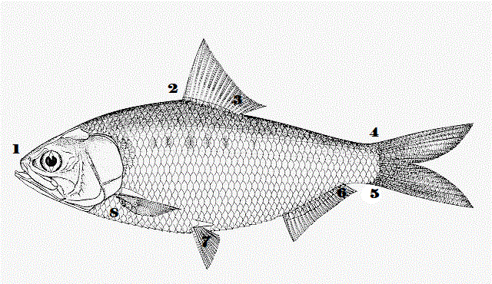
Landmark distances or truss measurements
Landmarks refer to some arbitrarily selected points on a fish’s body
With the help of these points, the individual fish shape can be analyzed

Slide 10
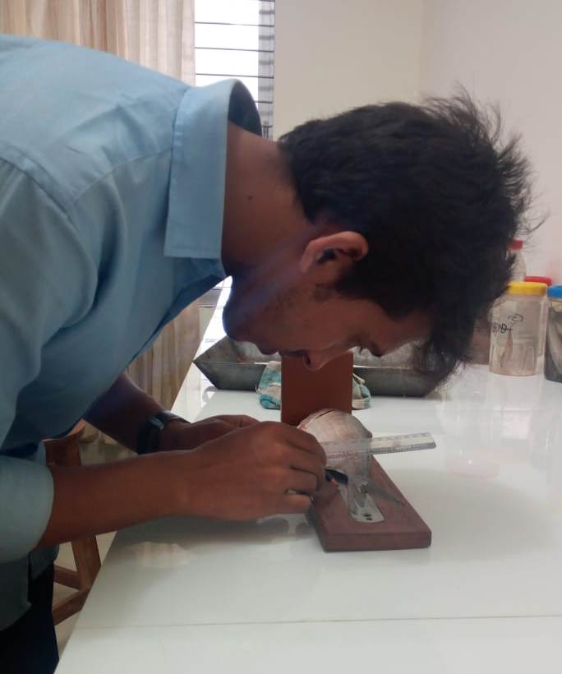
2. Measurement of morphometric characteristics
Sixteen morphometric characters were measured
Standard length (SL) | Caudal peduncle length (CPL)
Total length (TL) | Pectoral fin length (PtFL)
Fork length (FL) | Caudal fin length (CFL)
Pre-dorsal fin length (Pre-DFL) | Pre-anal fin length (PAL)
Dorsal fin length (DFL) | Anal fin length (AFL)
Post-dorsal fin length (Post-DFL | Highest body depth (HBD)
Pre-pelvic fin length (Pre-PvFL) | Least body depth (LBD)
Pelvic fin length (PvFL) | Pre-pectoral fin length (Pre-PtFL )

Slide 11
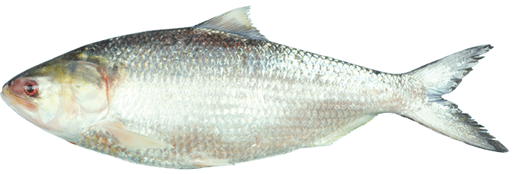
TL
FL
SL
Pre-DFL
DFL
Post-DFL
Pre-PcFL
Pre-PvFL
Pre-AFL
AFL
CPL
CFL
Fig: Different morphometric indices of Tenualosa sp. used in this study

Slide 12
3. Measurement of meristic characteristics
8 meristic characters were measured
Dorsal fin
Branchiostegeal Rays
Scales on LL and LT
Caudal fin
Anal fin
Pectoral fin
Pelvic fin

Slide 13
4. Measurement of landmark distances
Eight (8) landmark points outlining 14 distances were measured on the body
2
3
4
1
6
5
8
7

Slide 14
Sl. No. | Character codes | Landmark points | Description of characters
01 | A1 | 1-2 | Anterior tip of snout to the origin of dorsal fin base
02 | B1 | 2-3 | Origin of dorsal fin to the end of dorsal fin base
03 | C1 | 3-4 | End of dorsal fin base to origin of caudal fin
04 | D1 | 4-5 | Upper to lower of caudal fin origin
05 | E1 | 5-6 | Origin of lower of caudal fin to end of the anal fin base
06 | F1 | 6-7 | Origin of anal fin to origin of pelvic fin
07 | G1 | 7-8 | Origin of pelvic fin to origin of pectoral fin
08 | H1 | 8-1 | Origin of pectoral fin to the end of snout tip
09 | I2 | 2-7 | Origin of dorsal fin to origin of pelvic fin
10 | J2 | 2-6 | Origin of dorsal fin to origin of anal fin
11 | K2 | 3-7 | End of dorsal fin base to origin of pelvic fin
12 | L2 | 3-6 | End of dorsal fin base to origin of anal fin
13 | M2 | 3-5 | End of dorsal fin base to lower caudal fin origin
14 | N2 | 4-6 | Origin of the upper caudal fin to end of the anal fin base

Slide 15
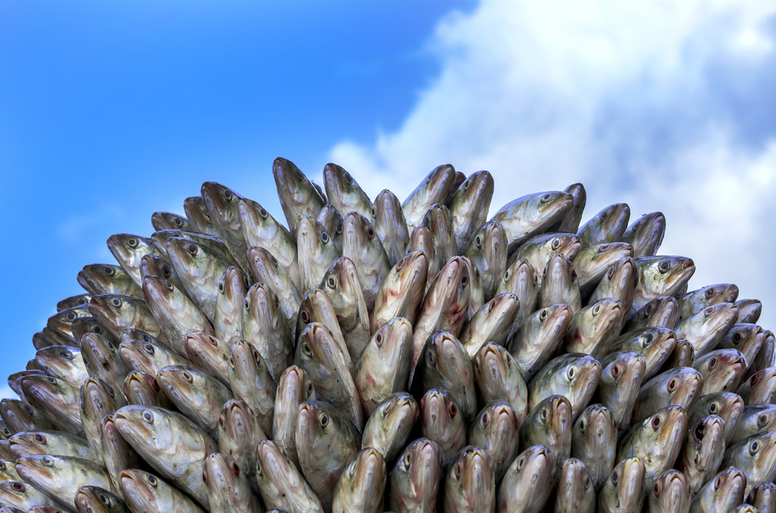
  Statistical analysis

Slide 16
Adjustment of data …
To remove the size effect
M_{adj}= M (Ls/Lo) ^{b}
Where,
  M _{adj}: size adjusted measurement
  M: original measurement
  Ls: overall mean of standard length for all fish from all samples in each analysis
  Lo: total length of fish
  b: slope of the regression of log M on log Lo
Elliott et al., (1995)

Slide 17
Analysis of adjusted data …
Kruskal-Wallis test (for meristic characters)
Univariate analysis of variance (ANOVA)
Discriminant functional analysis (DFA)
Principal component analysis (PCA)
Scatter plotting
Land-Mark distances and Morphometric Characters

Slide 18
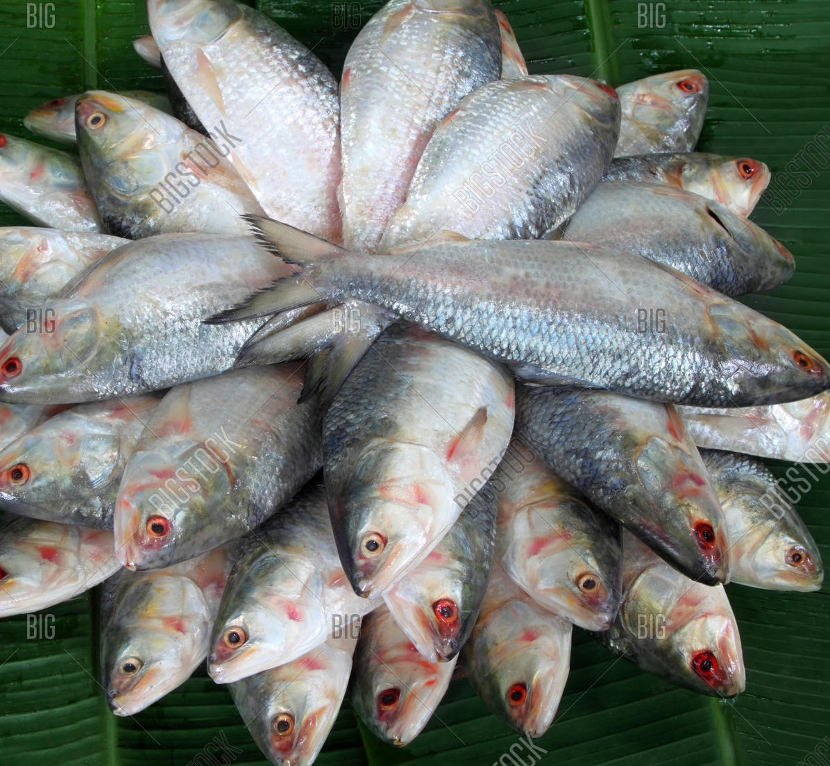
Results

Slide 19
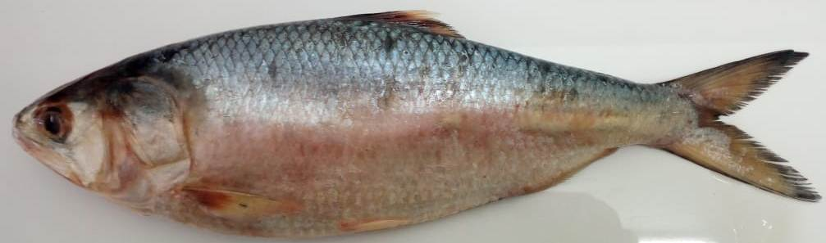
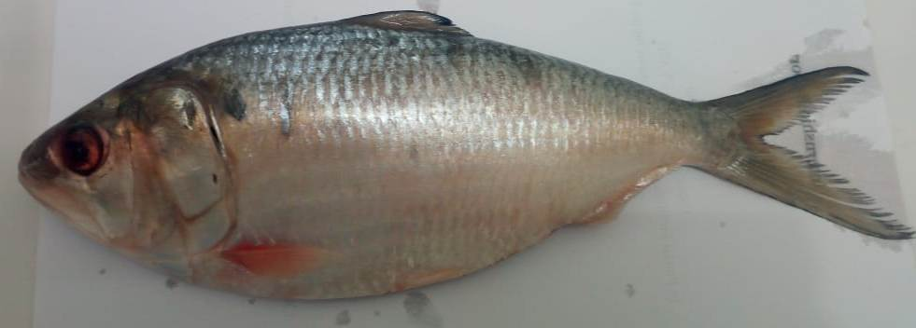
we present the details of systemic analytical observations of the morphology based on statistical approaches in two main parts…
Comparative studies on T. ilisha collected from three different habitats (marine, river, coastal)
Comparison between T. ilisha and T. toli of coastal habitat (Chittagong region)
T. ilisha T. toli

Slide 20
Comparative studies on T. ilisha collected from three different habitats
Analysis of meristic characters
No significant difference was observed in three different regions (Coastal, Marine and River) (Kruskal Wallis test and ANOVA)
Meristic characters | No.
Dorsal fin rays | 18-19
Pelvic fin rays | 7-8
Pectoral fin rays | 14-15
Anal fin rays | 17-21
Caudal fin rays | 26-28
Branchiostegeal rays | VI
Scales on the lateral line | 45-47
Scales on lateral transverse | 17-19

Slide 21
Comparative studies on T. ilisha collected from three different habitats…
Analysis of morphometric characters
8 morphometric characters were found significant among the stocks
Highest body depth (HBD)
Least body depth (LBD)
Post-dorsal fin length (Post-DFL)
Pre-pectoral fin length (Pre-PcFL)
Pelvic fin length (PvFL)
Pre-pelvic fin length (Pre-PvFL)
Anal fin length (AFL)
Caudal peduncle length (CPL)
TL
FL
SL
Pre-DFL
DFL
Post-DFL
Pre-PcFL
Pre-PvFL
Pre-AFL
AFL
CPL
CFL

Slide 22
Comparative studies on T. ilisha collected from three different habitats…
Analysis of morphometric characters
Discriminant Function Analysis: produced two sets (DF1, DF2)
DF1 (89.8%)- four measurements (LBD, AFL, Pre-PcFL, Pre-PvFL)
DF2 (10.2%)- eleven measurements (SL, FL, Pre-DFL, DFL, Post-DFL, PvFL, CFL, pre-AFL, HBD, CPL)
From this both observations it was obvious that…
First DF was much more informative in explaining differences among the stocks
Second DF explained much less of the variance than did the first DF

Slide 23
Comparative studies on T. ilisha collected from three different habitats…
Characters | Discriminant Function
 | DF 1 | DF 2
Least Body Depth (LBD) | -.416* | .169
Anal fin Length (AFL) | -.275* | .044
Pre Pectoral fin Length (Pre-PcFL) | -.174* | -.010
Pre-Pelvic fin length (Pre-PvFL) | -.152* | -.054
Pelvic fin length (PvFL) | -.284 | .706*
Highest Body Depth (HBD) | .256 | .349*
Post-dorsal fin length (Post-DFL) | .111 | .320*
Caudal Fin Length (CPL) | .269 | .291*
Fork Length (FL) | -.121 | .206*
Pre Anal Fin Length (Pre-AFL) | .085 | .206*
Dorsal Fin Length (DFL) | -.095 | -.170*
Pectoral fin Length (PcFL) | -.117 | .137*
Pre Dorsal Fin Length (Pre-DFL) | -.022 | -.130*
Caudal Fin Length (CFL) | .030 | -.110*
Standard Length (SL) | .055 | .109*
*. Largest absolute correlation between each variable and any discriminant functions
DFA

Slide 24
Comparative studies on T. ilisha collected from three different habitats…
Analysis of morphometric characters
Principle Component Analysis (PCA): 8 significant morphometric characters were further used for PCA
The PCA based on eight morphometric measurements retained two components with eigen values>1
PCA explain 52.13% of the total variance
The first (PC1) and second (PC2) principal components accounted for 38.31% and 13.87% of the total variance respectively
All the eight morphometric measurements had significant loadings on PC1
four (PvFL, HBD, LBD, Post-DFL) on PC2

Slide 25
Comparative studies on T. ilisha collected from three different habitats…
Morphometric Characters | Component
 | PC1 | PC2
Post dorsal fin length (Post-DFL) | -0.583 | 0.529
Pre pelvic fin length (Pre-PvFL) | 0.543
Pelvic fin length (PvFL) | 0.564 | 0.563
Pre pectoral fin length (Pre-PcFL) | 0.577
Anal fin length (AFL) | 0.788
Caudal fin length (CPL) | -0.715
Highest body depth (HBD) | -0.545 | 0.347
Least body depth (LBD) | 0.592 | 0.549
Eigen-values | 3.065 | 1.106
% of variance | 38.31 | 13.87
Cumulative variance % | 38.31 | 52.13
PCA

Slide 26
Comparative studies on T. ilisha collected from three different habitats…
Analysis of morphometric characters
Scatter plotting

Slide 27
Comparative studies on T. ilisha collected from three different habitats…
Analysis of landmark measurements
Following 8 landmark measurements were found significant among the stocks
1 to 2
2 to 3
3 to 4
4 to 5
6 to 7
8 to 1
2 to 6
3 to 6
2
3
4
1
6
5
8
7

Slide 28
Comparative studies on T. ilisha collected from three different habitats…
Analysis of landmark measurements
DF1 (87.4%)- two measurements (2 to 7, 4 to 5)
DF2 (12.6%)- twelve measurements
From this both observations it was obvious that…
first DF was much more informative in explaining differences among the stocks
second DF explained much less of the variance than did the first DF

Slide 29
Comparative studies on T. ilisha collected from three different habitats…
Landmark Distance | Discriminant Function
 | DFA 1 | DFA 2
D1 (4-5) | -.513* | .391
J2 (2-7) | -.194* | .179
A1 | -.014 | .649*
C1 | -.020 | .406*
H1 | -.050 | .387*
F1 | .078 | .351*
B1 | -.200 | .321*
L2 | -.175 | .281*
G1 | -.022 | .240*
M2 | -.046 | .221*
N2 | -.075 | .208*
E1 | .093 | .143*
K2 | .056 | .097*
I2 | .008 | -.051*
*. Largest absolute correlation between each variable and any discriminant function. Variables ordered by absolute size of correlation within function.
DFA

Slide 30
Comparative studies on T. ilisha collected from three different habitats…
Analysis of landmark measurements…….
Principle Component Analysis (PCA): 8 significant truss measurements were further used for PCA
The PCA based on eight truss measurements retained two components with eigen values>1
Explain 71.47% of the total variance
The first (PC1) and second (PC2) principal components accounted for 56.19% and 15.35% of the total variance respectively
All the eight truss measurement had significant loadings on PC1
The most significant loadings on PC2 were 1-2, 2-3, 4-5, 6-7, 8-1 and 2-6

Slide 31
Comparative studies on T. ilisha collected from three different habitats…
Landmark Distance | Component
 | PC1 | PC2
A1 (1-2) | 0.612 | 0.502
B1 (2-3) | 0.773 | -0.317
C1 (3-4) | 0.750
D1 (4-5) | 0.747 | -0.458
F1 (6-7) | 0.615 | 0.563
H1 (8-1) | 0.740 | 0.393
J2 (2-6) | 0.862 | -0.377
L2 (3-6) | 0.853
Eigen-values | 4.489 | 1.228
% of variance | 56.118 | 15.352
Cumulative variance % | 56.118 | 71.470
PCA

Slide 32
Comparative studies on T. ilisha collected from three different habitats…
Analysis of landmark measurements…….
Scatter plotting

Slide 33
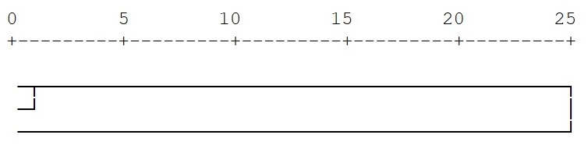
Figure: Dendrogram based on the morphometric and landmark distances
Comparative studies on T. ilisha collected from three different habitats…
Coastal
Marine
River

Slide 34
Comparison between T. ilisha and T. toli
Both Kruskal Wallis test and ANOVA showed significant differences between the two fish species (T. ilisha and T. toli) in case of meristic characters
Meristic characters | Tenualosa ilisha | Tenualosa toli
Dorsal fin rays | 18/19 | 17/18
Pelvic fin rays | 7/8 | 8
Pectoral fin rays | 14/15 | 14/15
Anal fin rays | 17-21 | 14/15
Caudal fin rays | 26-28 | 28/29
Branchiostegeal rays | VI | V
Scales on the lateral line | 45-47 | 40/41
Scales on lateral transverse | 17-19 | 13/14

Slide 35
Comparison between T. ilisha and T. toli………
Analysis of morphometric characters
Following 12 morphometric characters were found significant between the species
Fork length (FL)
Pre-dorsal fin length (Pre-DFL)
Dorsal fin length (DFL
Post-dorsal fin length (Post-DFL)
Pelvic fin length (PvFL)
Pre-pelvic fin length (Pre-PvFL)
Pre-pectoral fin length (PcFL),
Pectoral fin length (PcFL
Least body depth (LBD
Anal fin length (AFL)
Caudal peduncle length (CPL)
Caudal fin length (CFL)
TL
FL
SL
Pre-DFL
DFL
Post-DFL
Pre-PcFL
Pre-PvFL
Pre-AFL
AFL
CPL
CFL

Slide 36
Comparison between T. ilisha and T. toli………
Analysis of morphometric characters
Principle Component Analysis (PCA): 12 significant morphometric characters were further used for PCA
The PCA based on 12 morphometric measurements retained two components with eigen values>1
PCA explain 89.23% of the total variance
The first (PC1) and second (PC2) principal components accounted for 77.42% and 11.81% of the total variance respectively
All the twelve morphometric measurements had significant loadings on PC1
Two measurements (CFL, CPL) were significant on PC2

Slide 37
Comparison between T. ilisha and T. toli………
Analysis of Landmark distances
Following 13 landmark measurements were found significant between the stocks
1 to 2
2 to 6
2 to 7
3 to 6
3 to 7
3 to 4
3 to 5
4 to 5
4 to 6
5 to 6
6 to 7
7 to 8
8 to 1
2
3
4
1
6
5
8
7

Slide 38
Comparison between T. ilisha and T. toli………
Analysis of Landmark distances
Principle Component Analysis (PCA): 13 significant truss measurements were further used for PCA
The PCA based on 13 truss measurements retained two components with eigen values>1
PCA explain 88.29% of the total variance.
The first (PC1) and second (PC2) principal components accounted for 78.6% and 9.7% of the total variance respectively.
All the thirteen truss measurements had significant loadings on PC1
the most significant loadings on PC2 were 2-6, 3-4, 3-5, 3-6, 4-6, 5-6 and 6-7

Slide 39
Comparison between T. ilisha and T. toli………
Morphometric Characters | Component
 | PC1 | PC2
Fork Length (FL) | 0.968
Pre Dorsal fin length (Pre-DFL) | 0.981
Dorsal fin length (DFL) | -0.742
Post Dorsal fin length (Post-DFL) | -0.901
Pre Pelvic fin length (Pre-PvFL) | 0.992
Pelvic fin length (PvFL) | 0.973
Pre pectoral fin length (Pre-PcFL) | 0.981
Pectoral fin length (PcFL) | 0.880
Anal fin length (AFL) | -0.934
Caudal fin Length (CFL) | -0.331 | 0.901
Caudal peduncle length (CPL) | -0.656 | -0.650
Least body depth (LBD) | 0.974
Eigen-values | 9.290 | 1.417
% of variance | 77.421 | 11.811
Cumulative variance % | 77.421 | 89.231
Landmark Distances | Component
 | PC1 | PC2
A1 (1-2) | 0.912
C1 (3-4) | -0.866 | 0.444
D1 (4-5) | 0.950
E1 (5-6) | -0.660 | 0.332
F1 (6-7) | -0.692 | 0.429
G1 (7-8) | -0.936
H1 (8-1) | 0.983
I2 (2-7) | 0.983
J2 (2-6) | 0.907 | 0.337
K2 (3-7) | 0.978
L2 (3-6) | 0.915 | 0.337
M2 (3-5) | -0.880 | 0.413
N2 (4-6) | 0.788 | 0.516
Eigen-values | 10.218 | 1.260
% of variance | 78.603 | 9.691
Cumulative variance % | 78.603 | 88.294

Slide 40
Comparison between T. ilisha and T. toli………
Scatter plotting
(Morphometric Measurement)

Slide 41
Comparison between T. ilisha and T. toli………
Scatter plotting
(Landmark Distances)

Slide 42
Discussion
River population of T. ilisha is morphologically different from coastal or marine populations of T. ilisha
T. toli is also far more different from T. ilisha
Variation may be attributed due to separate geographical location as well as the environmental and physiological constrains like salinity, temperature, turbidity, water pressure, current flow and food availability
Morphometric characters with truss measurements can be used as a common tool for determining variations among and between species

Slide 43
Conclusion
For proper conservation and management of any population, it is needed to know about their biology and population structure
This study has provided important morphological information that can be used to differentiate this Tenualosa sp. more precisely among groups and species
Hoping that the information obtained from the present study will be helpful for fisheries, biologists, and taxonomist concerned with these two fish species

Slide 44
Acknowledgement
Honorable Vice-chancellor (Prof. Dr. Goutam Buddha Das)
Honorable Dean (Prof. Dr. Mohammed Nurul Absar Khan)
My supervisor (Md. Moudud Islam, Assistant Professor and Head)
Honorable teacher Md. Mahiuddin Zahangir (Assistant Professor)
My co-supervisor (Joyshri Sarker, Assistant Professor and Head)
All other faculty members of my department
My family members, friends and all of my well-wishers

Slide 45

THANK YOU ALL

